Slide 1
Accelerated Architectures
EPCC
The University of Edinburgh

Slide 2
Outline
Why do we want/need accelerators such as GPUs?
Architectural reasons for accelerator performance advantages
Latest accelerator Products
(current) Market leader: NVIDIA
Alternatives: AMD GPUs, Intel Xeon Phi
Accelerated Systems
Notes:
Why need, why good, How do we make supercomputers

Slide 3
4 key performance factors
Amount of data processed at one time (Parallel processing)
Processing speed on each data element (Clock frequency)
Amount of data transferred at one time (Memory bandwidth)
Time for each data element to be transferred (Memory latency)
Processor
DATA PROCESSED
DATA IN
DATA OUT
Memory
Notes:
Here we have pic of proc –don’t know more yet –
Has to be attached to mem
Mem in, process, mem out
Interested in how fast it can be done

Slide 4
4 key performance factors
Parallel processing
Clock frequency
Memory bandwidth
Memory latency
Processor
DATA PROCESSED
Different computational problems are sensitive to these in different ways from one another
Different architectures address these factors in different ways
DATA IN
DATA OUT
Memory

Slide 5
CPUs: 4 key factors
Parallel processing
Until relatively recently, each CPU only had a single core. Now CPUs have multiple cores, where each can process multiple instructions per cycle
Clock frequency
CPUs aim to maximise clock frequency, but this has now hit a limit due to power restrictions (more later)
Memory bandwidth
CPUs use regular DDR memory, which has limited bandwidth
Memory latency
Latency from DDR is high, but CPUs strive to hide the latency through:
Large on-chip low-latency caches to stage data
Multithreading
Out-of-order execution
Notes:
Take CPUs for start
Multi-level parallel –vector per core, multi-core
Freq used to increase

Slide 6
The Problem with CPUs
The power used by a CPU core is proportional to Clock Frequency x Voltage²
In the past, computers got faster by increasing the frequency
Voltage was decreased to keep power reasonable.
Now, voltage cannot be decreased any further
1s and 0s in a system are represented by different voltages
Reducing overall voltage further would reduce this difference to a point where 0s and 1s cannot be properly distinguished
Notes:
Fundamental problem with CPUs power/energy

Slide 7
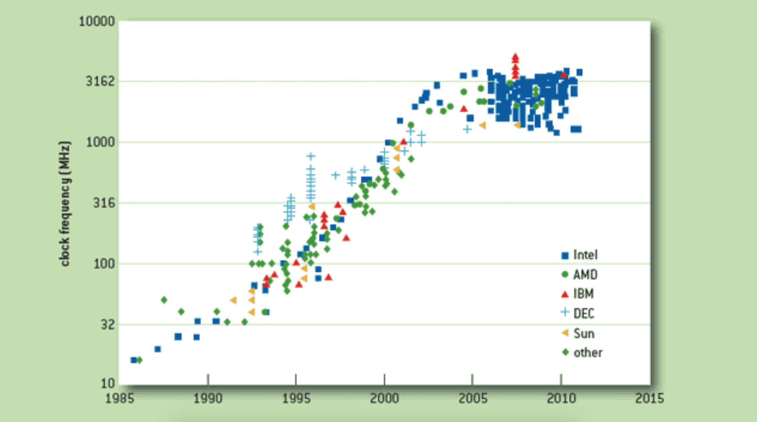
The Problem with CPUs
http://queue.acm.org/detail.cfm?id=2181798
Notes:
Fundamental problem with CPUs power/energy

Slide 8
The Problem with CPUs
Instead, performance increases can be achieved through exploiting parallelism
Need a chip which can perform many parallel operations every clock cycle
Many cores and/or many operations per core
Want to keep power/core as low as possible
Much of the power expended by CPU cores is on functionality not generally that useful for HPC
e.g. branch prediction

Slide 9
Accelerators
So, for HPC, we want chips with simple, low power, number-crunching cores
But we need our machine to do other things as well as the number crunching
Run an operating system, perform I/O, set up calculation etc
Solution: “Hybrid” system containing both CPU and “accelerator” chips

Slide 10
Accelerators
It costs a huge amount of money to design and fabricate new chips
Not feasible for relatively small HPC market
Luckily, over the last few years, Graphics Processing Units (GPUs) have evolved for the highly lucrative gaming market
And largely possess the right characteristics for HPC
Many number-crunching cores
GPU vendors NVIDIA and AMD have tailored existing GPU architectures to the HPC market
GPUs now firmly established in HPC industry

Slide 11
Accelerators
Intel released a different type of accelerator to compete with GPUs for scientific computing
Many Integrated Core (MIC) architecture
AKA Xeon Phi (codenames Larrabee, Knights Ferry, Knights Corner, Knights Landing)
Intel prefered the term “coprocessor” to “accelerator”
KNC comprised old Pentium CPU cores from 1993
Augmented with wide vector units
So again uses concept of many simple low-power cores
Each performing multiple operations per cycle
Intel Xeon Phi KNH cancelled:
End of Xeon Phi era

Slide 12
Latest Technology
NVIDIA
Volta GPUs have evolved from GeForce series
Image: https://www.nvidia.com/en-us/data-center/tesla-v100/
AMD
FirePro HPC specific GPUs have evolved from (ATI) Radeon series
Image: https://www.amd.com/en/products/servers-graphics?utm_medium=redirect&utm_source=301
Intel
Xeon Phi emerged to compete with GPUs for general purpose computation
Image: https://software.intel.com/en-us/xeon-phi/mic

Slide 13
Accelerators addressing performance
Parallel processing and clock frequency:
Focus on many number crunching cores.
(instead of few high-power cores)

Slide 14
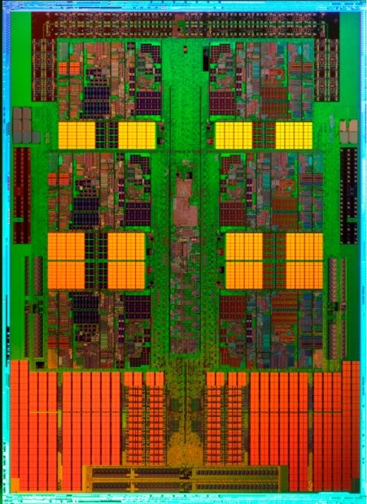
AMD 12-core CPU
Not much space on CPU is dedicated to compute
= compute unit
(= core)

Slide 15
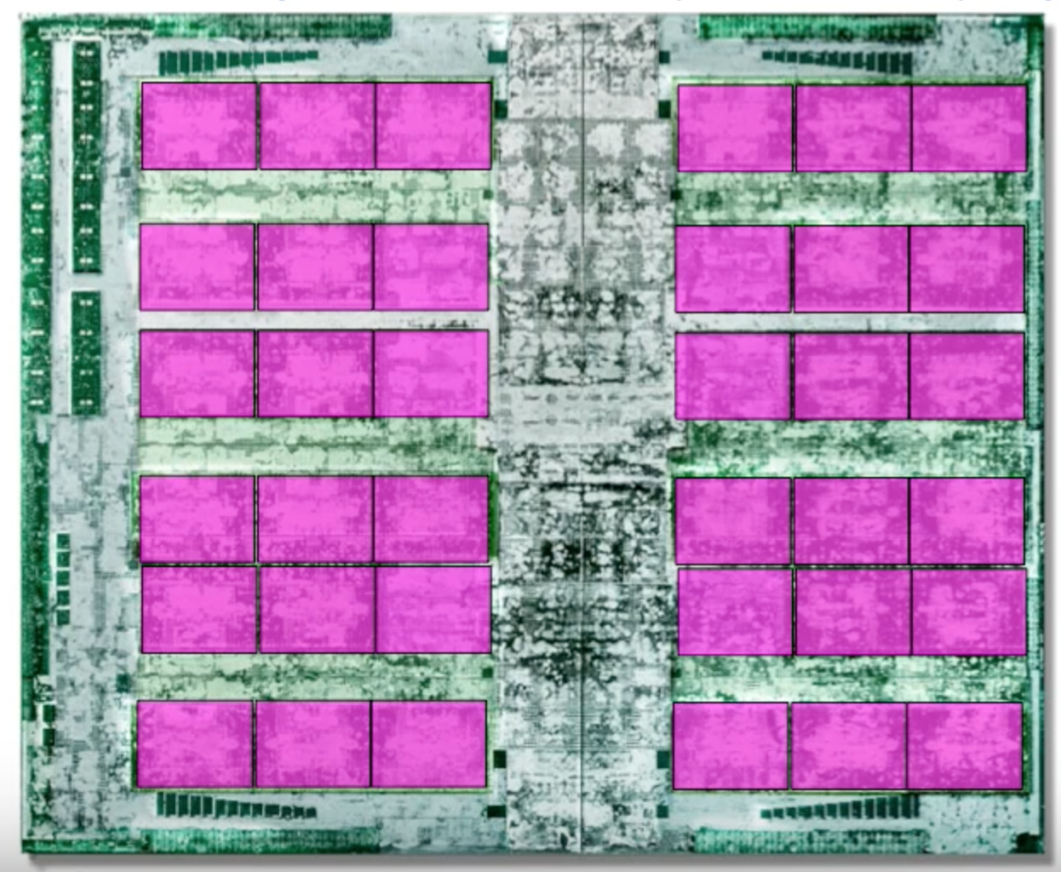
NVIDIA Pascal GPU
GPU dedicates much more space to compute
At expense of caches, controllers, sophistication etc
= compute unit
(= SM
= 64 CUDA cores)

Slide 16
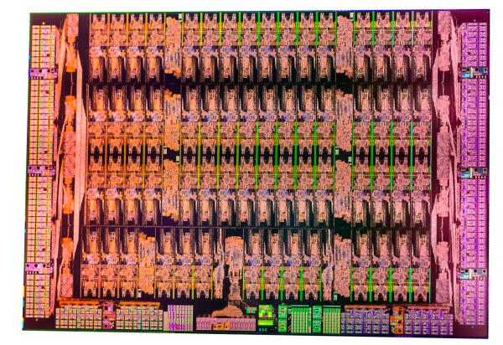
Intel Xeon Phi
As does Xeon Phi
= compute
unit
(= core)

Slide 17
Accelerators addressing performance
Parallel processing and clock frequency:
Focus on many number crunching cores.
(instead of few high-power cores)
Memory bandwidth and latency:
GDDR and later HBM offer significantly higher bandwidth vs DDR
Latency hidden by high parallelism, low cost context switching and (some) cache memory.

Slide 18
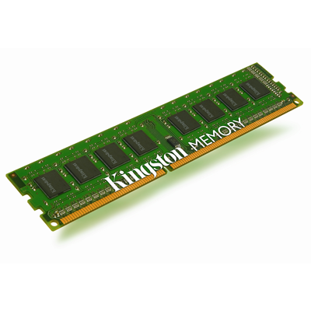
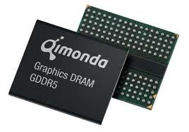
Memory
GPUs and Intel Xeon Phi both uses Graphics memory: much higher bandwidth
GPUs and Xeon Phi
use Graphics DRAM
CPUs use DRAM
For many applications, performance is very sensitive to memory bandwidth

Slide 19
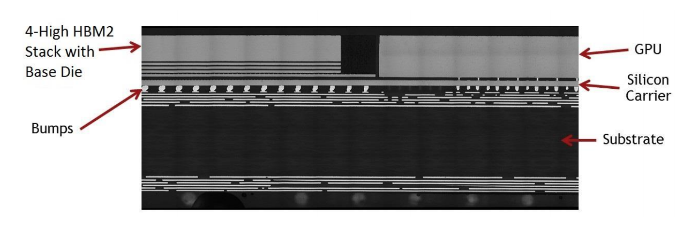
Memory
NVIDIA Pascal introduced stacked memory
Cross-section Photomicrograph of a P100 HBM2 stack and GP100 GPU
Similar staked memory used in Intel KNL (last version of Xeon Phi) and newer GPUs
(Image credits: NVIDIA Pascal architecture White Paper https://images.nvidia.com/content/pdf/tesla/whitepaper/pascal-architecture-whitepaper.pdf )

Slide 20
Accelerators: 4 key factors
Parallel processing
Accelerators have a much higher extent of parallelism than CPUs. Many more cores and/or operations per core
Clock frequency
Accelerators typically have lower clock-frequency than CPUs, and instead get performance through parallelism
Memory bandwidth
Accelerators use high bandwidth GDDR memory or HBM2 memory
Memory latency
Memory latency from GDDR is similar to DDR
GPUs hide latency through very high levels of multithreading
Xeon Phi hides latency in a similar way to CPUs, although the caches are smaller and no out-of-order execution (in current models).

Slide 21
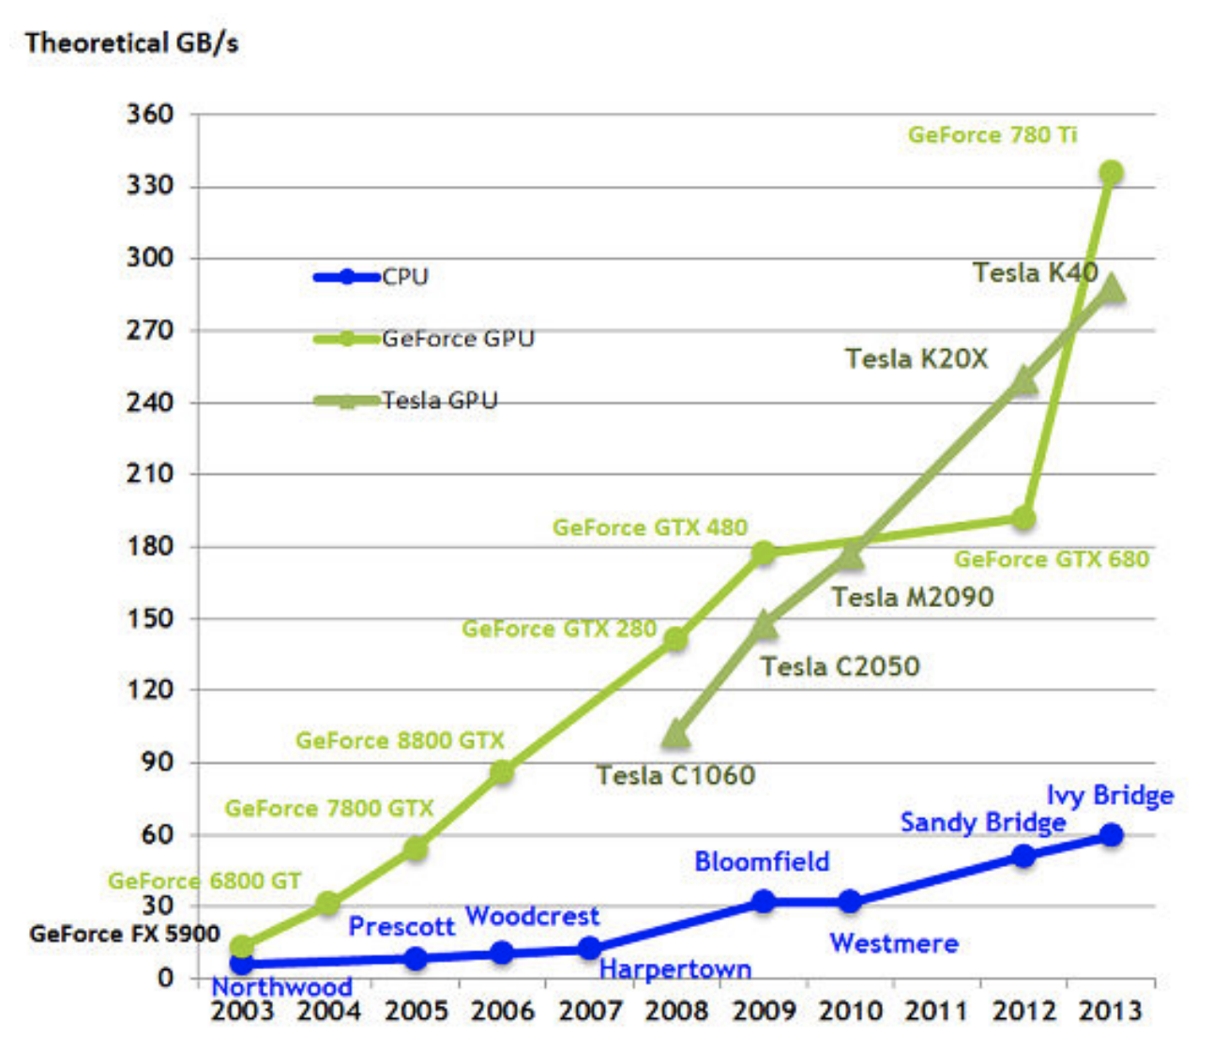
GPU performance has been increasing much more rapidly than CPU
Image: https://arxiv.org/pdf/1412.7789.pdf

Slide 22
GPUs accelerated systems
GPUs cannot be used instead of CPUs
They must be used together
GPUs act as accelerators
Responsible for the computationally expensive parts of the code
CPU-GPU communication (BW/latency) presents bottleneck
DRAM
HBM
CPU
GPU
I/O
I/O

Slide 23
GPUs accelerated systems
Performance considerations
Need to exploit high level of parallelism
Generally speaking: separate CPU-GPU memory space
Need to consider transfer to/from GPU-CPU
HBM generally lower capacity than DDR per GPU/CPU
Added complexity of programming model
Need to take the above into consideration
For GPU Cuda, OpenCL
OpenMP or OpenACC
for directives based approach.
Libraries and high level
programming languages can help.
DRAM
HBM
CPU
GPU
I/O
I/O

Slide 24
Xeon Phi accelerated systems
Xeon Phi run their own OS
Xeon Phi more independent from CPU
KNC was “card” accelerator and could run in three modes:
Offload: Highly parallel regions ”offloaded” to XeonPhi similar to GPU acceleration
Native mode: Log into Xeon Phi card and run directly on KNC
Symmetric: Run across CPU+KNC as if across nodes
KNL only available in socket version
Replaced CPU completely
DRAM
DRAM
GDRAM
HBM2
KNL
CPU
KNC
I/O
I/O
I/O

Slide 25
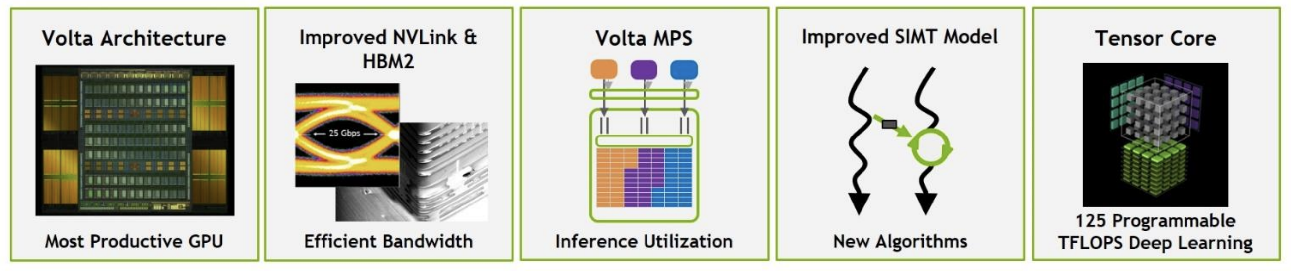
NVIDIA Volta look inside
NVIDIA’s latest GPU product is highly AI/DL oriented
Follows basic building blocks of previous architectures with notable improvements
Image courtesy of Alan Grey, NVIDIA

Slide 26
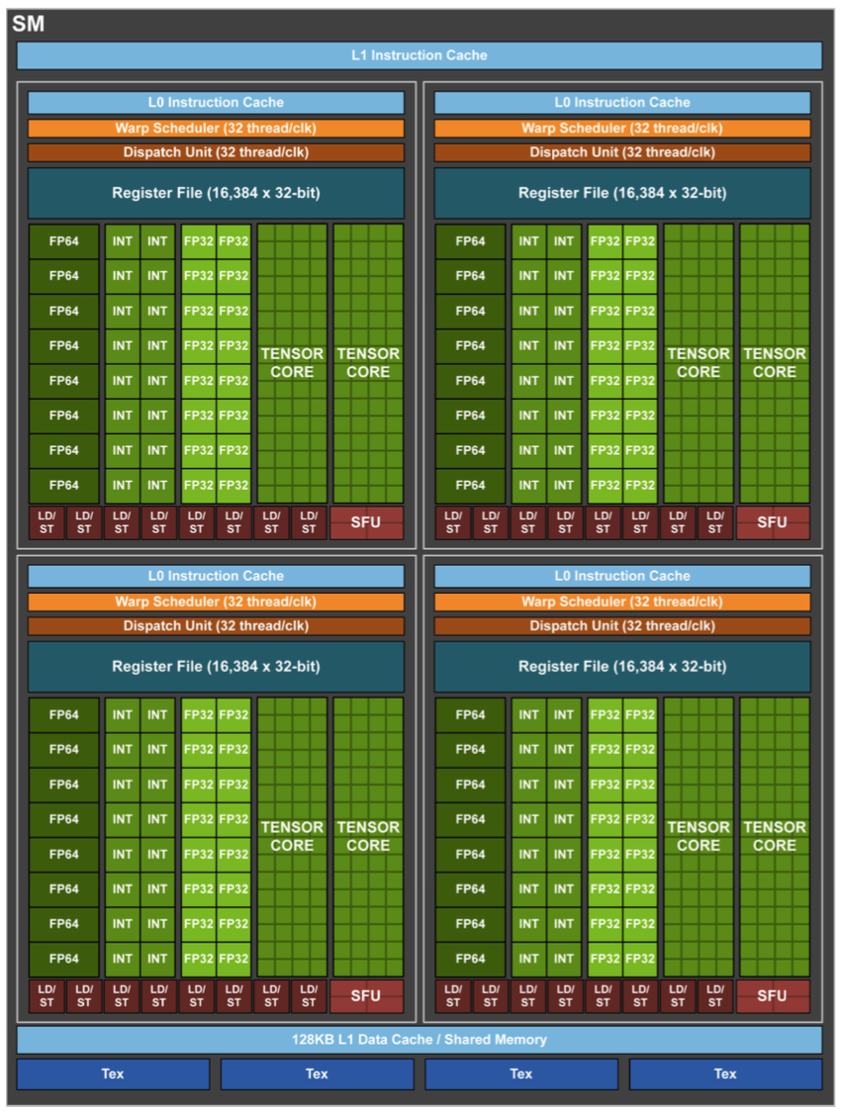
NVIDIA Volta
Volta GV100 SM
Chip partitioned into Streaming Multiprocessors (SMs) that act independently of each other
4 processing blocks per SM, each with:
16 FP32 Cores
8 FP64 Cores
16 INT32 Cores
2 Tensor cores
L0 instruction cache
1 warp scheduler
1 dispatch unit
64 KB Register File.
Number of SMs, and processing blocks etc per SM, varies across products. High-end GPUs have more than 1,000 total “cores”
Image courtesy of Alan Grey, NVIDIA

Slide 27
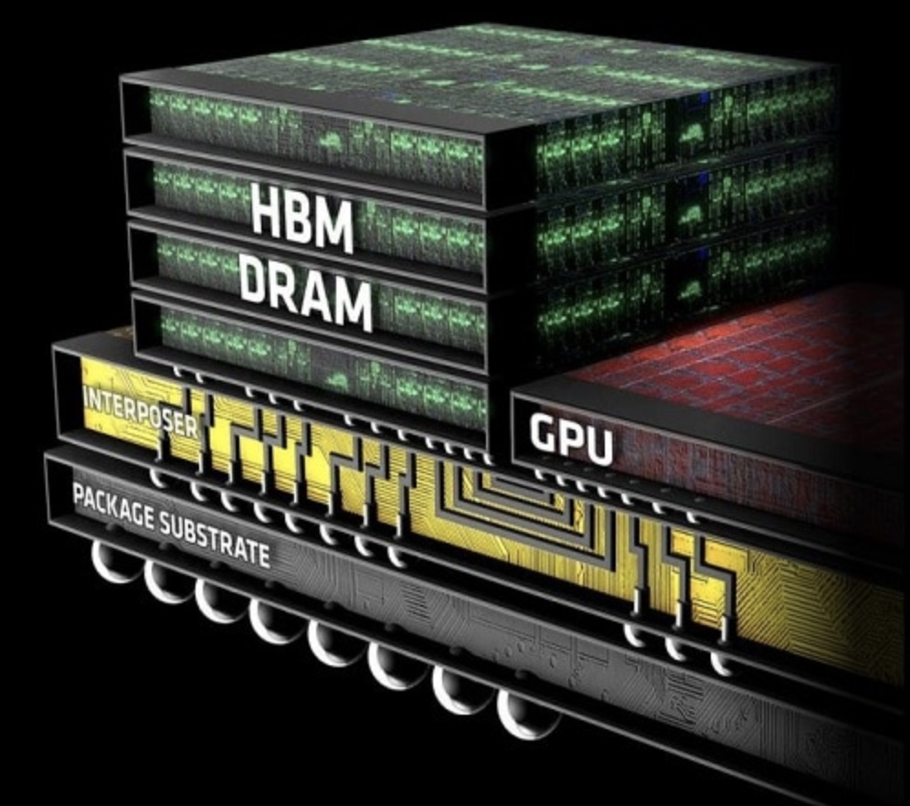
NVIDIA Volta
Volta GV100 HBM2
Up to eight memory dies per HBM2 stack
Up to four stacks
Maximum of 32 GB of GPU memory.
Image: https://www.eteknix.com/samsung-sk-hynix-supply-hbm2-nvidia/

Slide 28
NVIDIA Volta
Volta GV100 HBM2
Up to eight memory dies per HBM2 stack
Up to four stacks
Maximum of 32 GB of GPU memory.
Cache
128KB configurable
Data Cache and/or
Shared memory
For example, if shared memory is configured to 64 KB, texture and load/store operations can use the remaining 64 KB of L1.
Image courtesy of Alan Grey, NVIDIA

Slide 29
NVIDIA Volta
NVLink
Proprietary NVIDIA interconnect
Introduced with Pascal generation GPUs
Each NVLink connection achieving approximately 50GB/sec
Single V100 can support 6 NVlink connections
Achieving up to 300GB/sec
3x that of PCIe Gen 3
Can be used for GPU-GPU communication
Can also be used for CPU-GPU communication
(Currently) only with IBM Power CPU
Notably not available with Intel CPUs

Slide 30
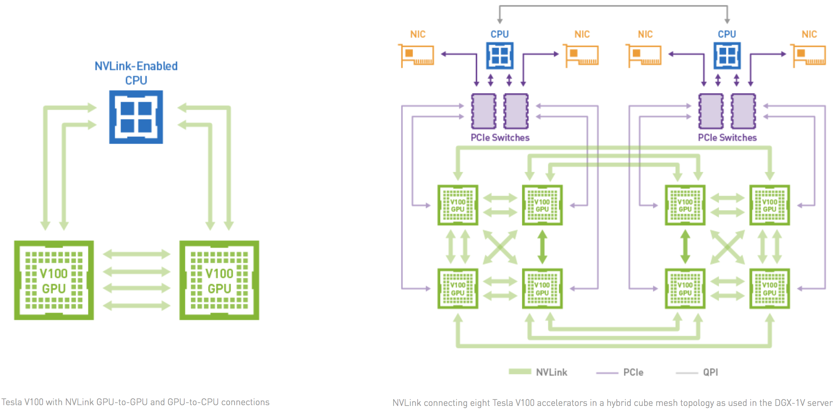
NVIDIA Volta
NVLink
Image: https://www.nvidia.com/en-us/data-center/nvlink/

Slide 31
NVIDIA Volta for DL
Tensor cores
Matrix multiply engines
Each Tensor Core performs the following operation: D = AxB + C, where A, B, C, and D are 4x4 matrices. The matrix multiply inputs A and B are FP16 matrices, while the accumulation matrices C and D may be FP16 or FP32 matrices.
Exploit “forgiving” nature of DL problems
Might prove useful for some HPC codes
Each Volta has 640 tensor cores, each performing 64 floating-point fused-multiply-add (FMA) operations per clock
125TFLOPs for training and inference

Slide 32
NVIDIA Volta
Tensor cores
Animation: https://www.nvidia.com/en-us/data-center/tensorcore/
Notes:
Up to 3x throughput vs Pascal

Slide 33
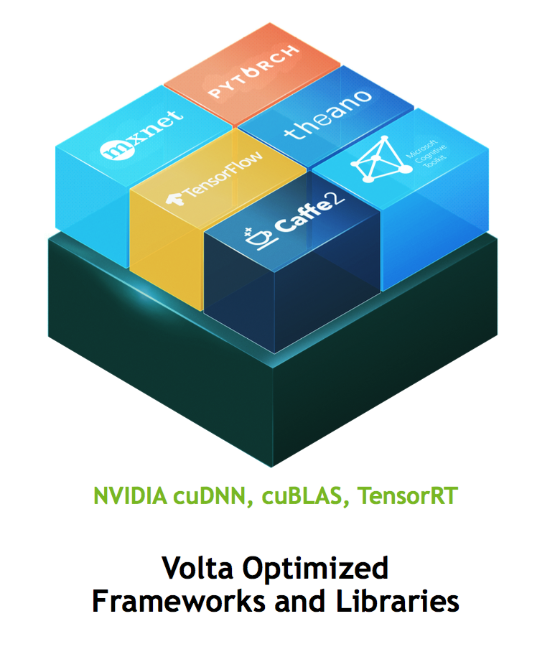
NVIDIA Volta
Optimised software
Image courtesy of Alan Grey, NVIDIA

Slide 34
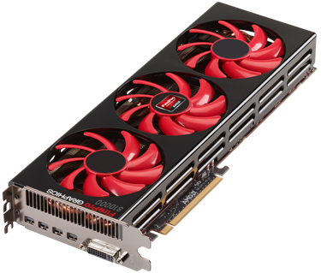
AMD FirePro
AMD acquired ATI in 2006
AMD FirePro series: derivative of Radeon chips with HPC enhancements
Like NVIDIA, High computational performance and high-bandwidth graphics memory
Currently much less widely used for GPGPU than NVIDIA, because of programming support issues

Slide 35
Intel Xeon Phi
Intel Pentium P54C cores were originally used in CPUs in 1993
Simplistic and low-power compared to today’s high-end CPUs
KNL moved from Pentium to Silvermont architecture cores (adapted from Atom mobile range)
Faster single thread performance
Also integrating network controllers on chip
Philosophy behind Phi is to dedicate large fraction of silicone to many of these cores
And, similar to GPUs, original Phi used MCDRAM Memory
Higher memory bandwidth than standard DDR memory used by CPUs
KNL Stacked MCDRAM : 400GB/sec bandwidth
KNL to DRAM : ~90GB/sec bandwidth

Slide 36
Intel Xeon Phi
On KNL, each core has been augmented with two wide 512-bit vector unit
For each clock cycle, each core can operate 2 vectors of size 8 (in double precision)
Twice the width of 256-bit “AVX” instructions supported by current CPUs
Multiple cores, each performing multiple operations per cycle
Peak performance and memory bandwidth similar to GPUs
Vector units drive performance

Slide 37
Programming
GPUs
CUDA: Extensions to the C language which allow interfacing to the hardware (NVIDIA proprietary)
OpenCL: Similar to CUDA but cross-platform (including AMD and NVIDIA)
Directives based approach: directives help compiler to automatically create code for GPU. OpenACC and now also new OpenMP 4.0
Libraries like CuFFT, NVBLAS can also help.
Xeon Phi
Can just use regular CPU code with OpenMP
Typically needs work to allow compiler to auto-vectorise efficiently
Intel specific directives allow offloading to phi, such that fast CPU core can be used for serial parts of code
Also Intel Thread Building Blocks
Often need intrinsics to fully exploit performance capabilities
Notes:
Intel greatest benefit is also drawback

Slide 38
GPU Accelerated Systems
CPUs and Accelerators are used together
Communicate over PCIe bus or NVLink
DRAM
HBM
CPU
Accelerator
PCIe
I/O
I/O
Can also be nvlink

Slide 39
Scaling to larger systems
Can have multiple CPUs and accelerators within each “workstation” or “shared memory node”
E.g. 2 CPUs +2 Accelerators (below)
CPUs share memory, but Accelerators do not
PCIe / nvlink
I/O
I/O
CPU
Accelerator +
HBM
Interconnect
nvlink
DRAM
CPU
Accelerator +
HBM
Interconnect allows multiple nodes to be connected
PCIe / nvlink
I/O
I/O

Slide 40
GPU Accelerated Supercomputer
Acc.+CPU
Node
Acc.+CPU
Node
…
Acc.+CPU
Node
Acc.+CPU
Node
Acc.+CPU
Node
…
Acc.+CPU
Node
…
…
…
Acc.+CPU
Node
Acc.+CPU
Node
…
Acc.+CPU
Node

Slide 41
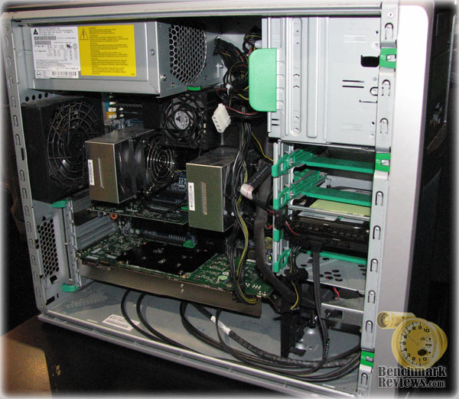
DIY GPU Workstation
Just need to slot GPU card into PCI-e
Need to make sure there is enough space and power in workstation

Slide 42
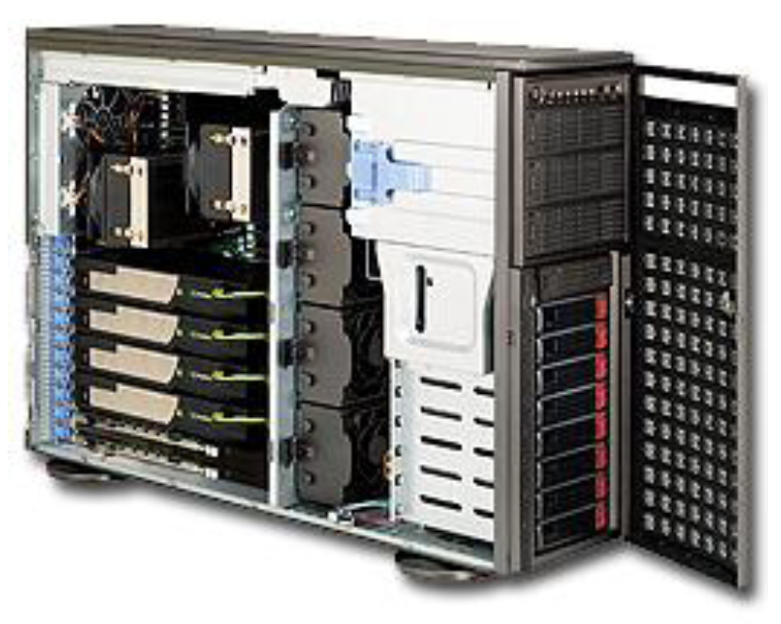
GPU Servers
Multiple servers can be connected via interconnect
Several vendors offer GPU Servers
Example Configuration:
4 GPUs plus 2 (multi-core) CPUs

Slide 43

Summit - ORNL
https://www.olcf.ornl.gov/summit/
Each node:
2x 22core Power9 CPUs
6x NVIDIA V100 GPUs
512 GB DDR4
Mellanox EDR 100G InfiniBand
x4,608 nodes
https://www.olcf.ornl.gov/summit/
Notes:
++ COOLING

Slide 44
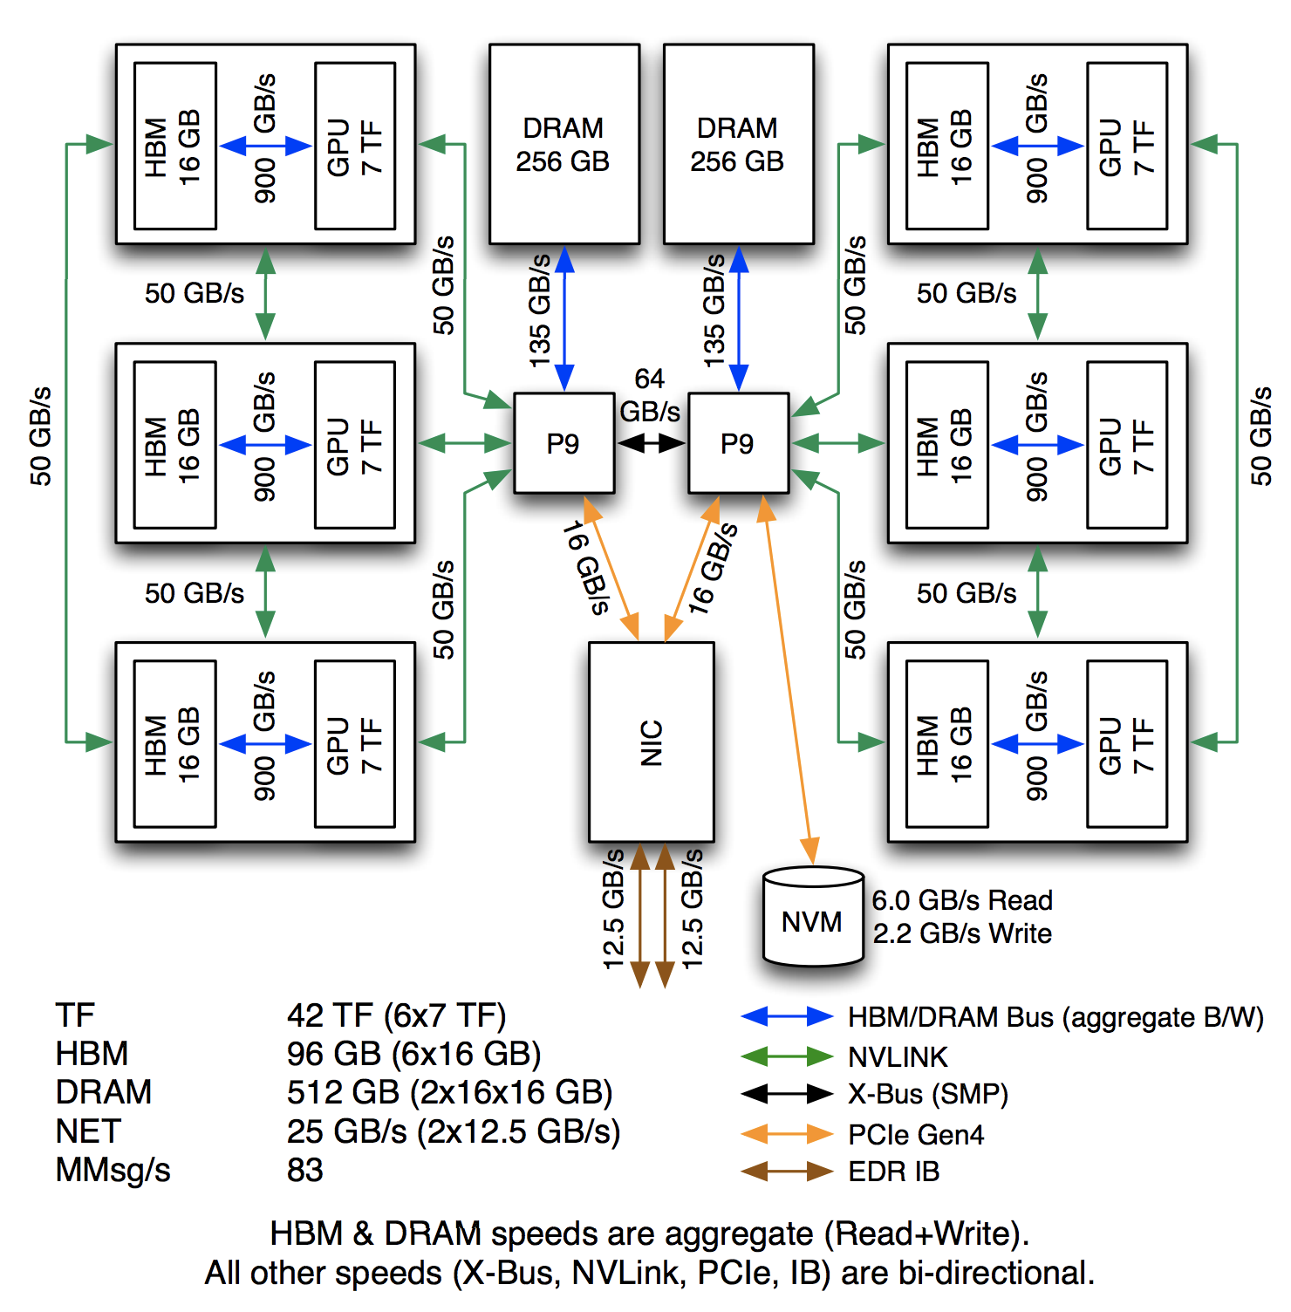
Summit - ORNL
https://www.olcf.ornl.gov/summit/
https://www.olcf.ornl.gov/wp-content/uploads/2018/05/Intro_Summit_System_Overview.pdf
Notes:
Point to significance of interconnect

Slide 45
Summit - ORNL
Number 1 machine in the world
~187 PFlop/s peak performance
~122 PFlop/s max performance
~2,300,000 cores
8.8 MW
Power9 system + GPU + Liquid Cooling
EXAOP (not Flop) DL run already a reality:
https://www.olcf.ornl.gov/2018/06/08/genomics-code-exceeds-exaops-on-summit-supercomputer/
https://www.olcf.ornl.gov/summit/
Notes:
Achieved ExaOp performance on AI applications:
Mixed precision
1.8 EXAOPS or 2 billion billion ops
Even 200 PFLOPS = Earth entire population 305 days to do what Summit = 1 second
HDD: 250PB = 74years HD video
Exascale is looking to build a system which can within a 20-30MW envelope
Though summit is not there, it is making significant leaps forward

Slide 46
Going forward
Some very interesting developments on the horizon
NVIDIA GPUs are current frontrunner
5 out of 10 of top10 systems use NVIDIA GPUs
Intel focusing on Intel Xeon CPUs (not to be confused with end-of-life Intel Xeon Phi co-processors)
AMD has shown promising technology but still lags in software support
FPGAs and CPUs with FPGAs are becoming more and more relevant due to power efficiency and performance:
Not “exactly” an accelerator
Separate lecture on FPGAs coming in a few weeks

Slide 47
Summary
Accelerators have higher compute and memory bandwidth capabilities than CPUs
Silicon dedicated to many simplistic cores
Use of stacked memory
Accelerators are typically not used alone, but work in tandem with CPUs
Most common are NVIDIA GPUs and Intel Xeon Phis.
Architectures differ
AMD also have high performance GPUs, but not so widely used due to programming support
GPU accelerated systems scale from simple workstations to large-scale supercomputers
And dominate the top10 most powerful systems as of June 2018

